Slide 1


Hospital
Your CARE is ours….
Group 1 Kenneth Charette, Kenneth Cruz, Vijayalakshmi Kuppuswamy, Jesh Amera, Wei Wang

Slide 2
Task
Our team was assigned to build a hospital based on specific features received from the Product Owner.
Specifications:
Hospital is 2 floors.
10 different hospital wings in total.
Each wing is a different color and consists of at least 5 rooms.
Same amount of rooms and wings for each floor
Parking Lot
Accessible (Elevators)
Emergency Exits
Heli-pad
Cafeteria
Restrooms
Front-desk / Check-in area
Prayer rooms
Gift Shop

Slide 3
Project
This hospital is a two-story building with a front parking lot, a back parking lot and a helipad right next to the back parking lot.
The front parking lot is for the visitors, patients and emergency vehicles and the back parking lot is for the employees.
The first floor has a welcome area and a gift store on the right hand side. There are 3 wings on each side of the first floor and each wing has one hallway, one bathroom and 3 - 6 rooms, each room has big windows so that the nature sunlight can come in. In the center of the building is the outdoor cafeteria with 200 seats and a kitchen. There is an elevator and couple of stairs lead to the second floor and two emergency exits by the end of both right and left side hallways.
The second floor has basically the same structure as the first floor, it totally has 4 sets of rooms, 2 meeting offices, a prayer room, couple of bathrooms and a dining room. It also has two emergency exits by the end of both right and left side hallways and each emergency exit has a stair leads to the first floor.

Slide 4
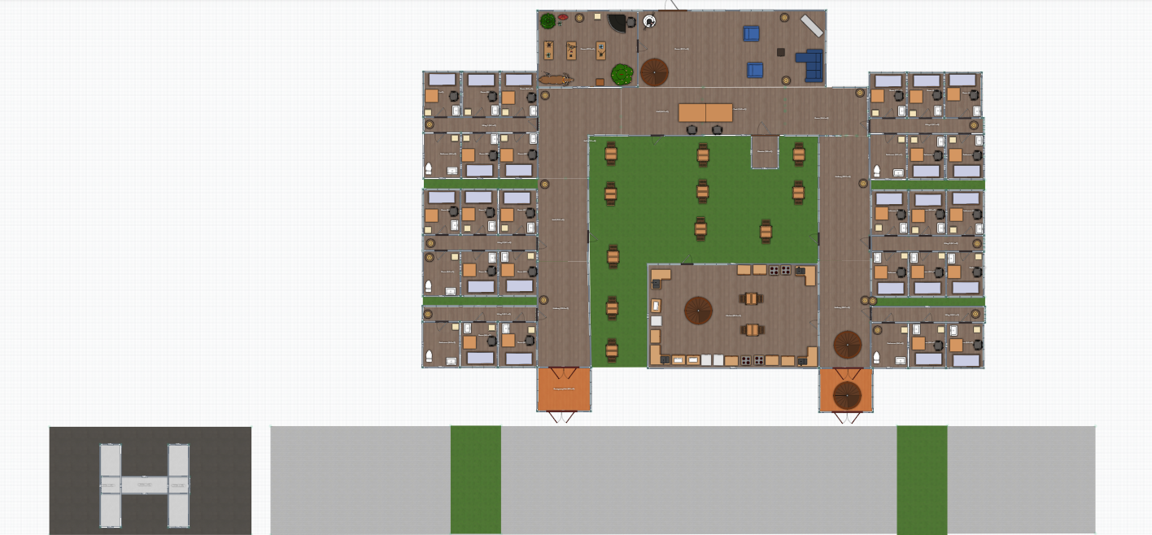
Floor 1 (Screenshots) 2D View #1

Slide 5
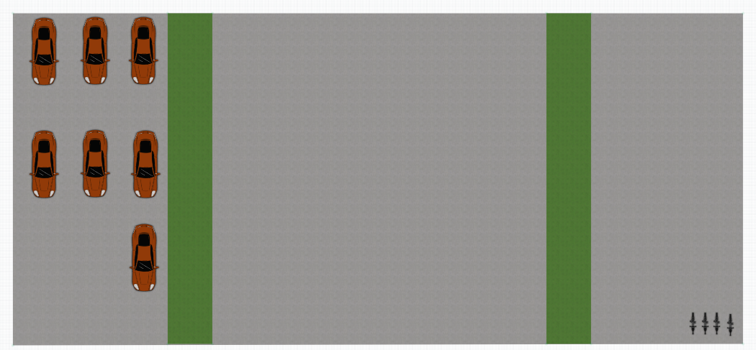
Parking Lot (Screenshots) 2D View

Slide 6
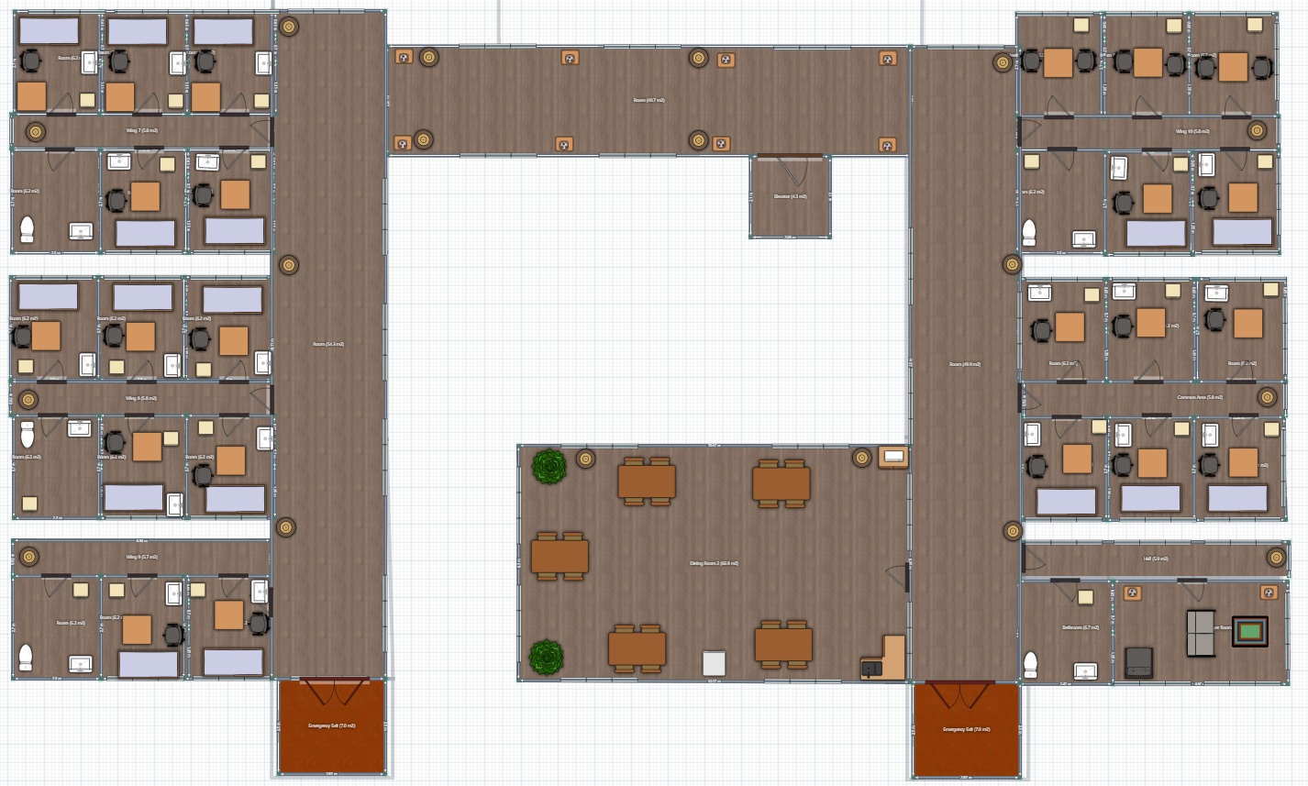
Floor 2 (Screenshots) 2D View #1

Slide 7
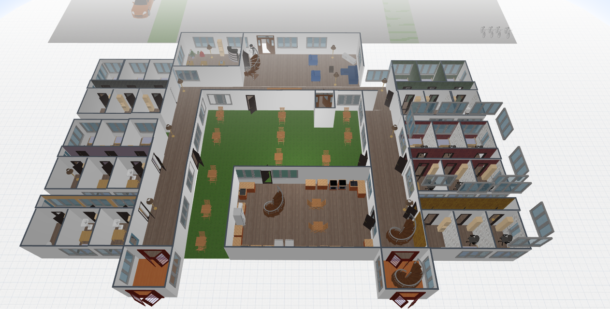
Floor 1 (Screenshots) 3D View #1

Slide 8
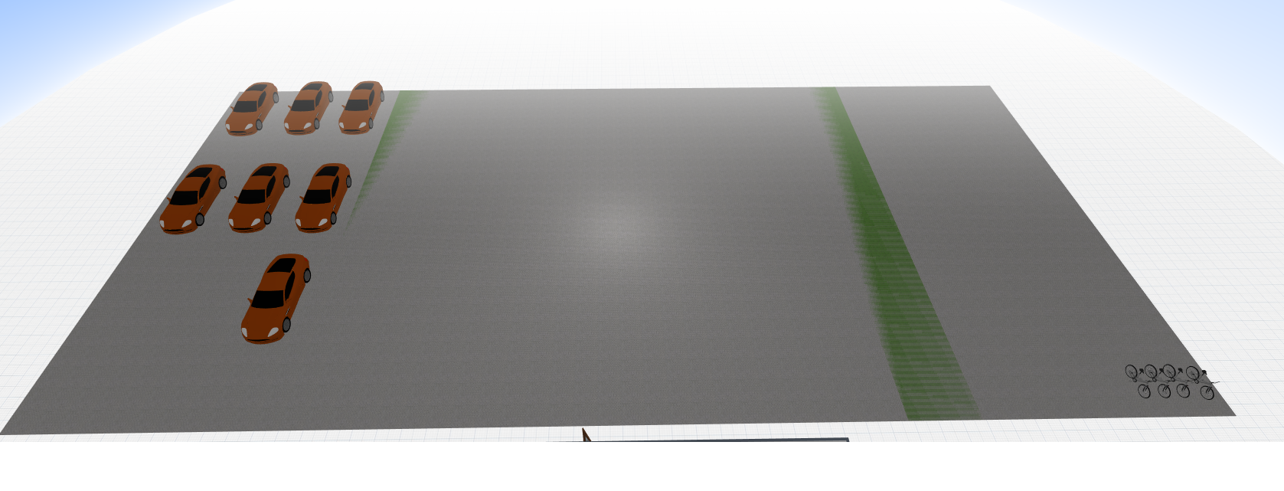
Parking Lot (Screenshots) 3D View

Slide 9
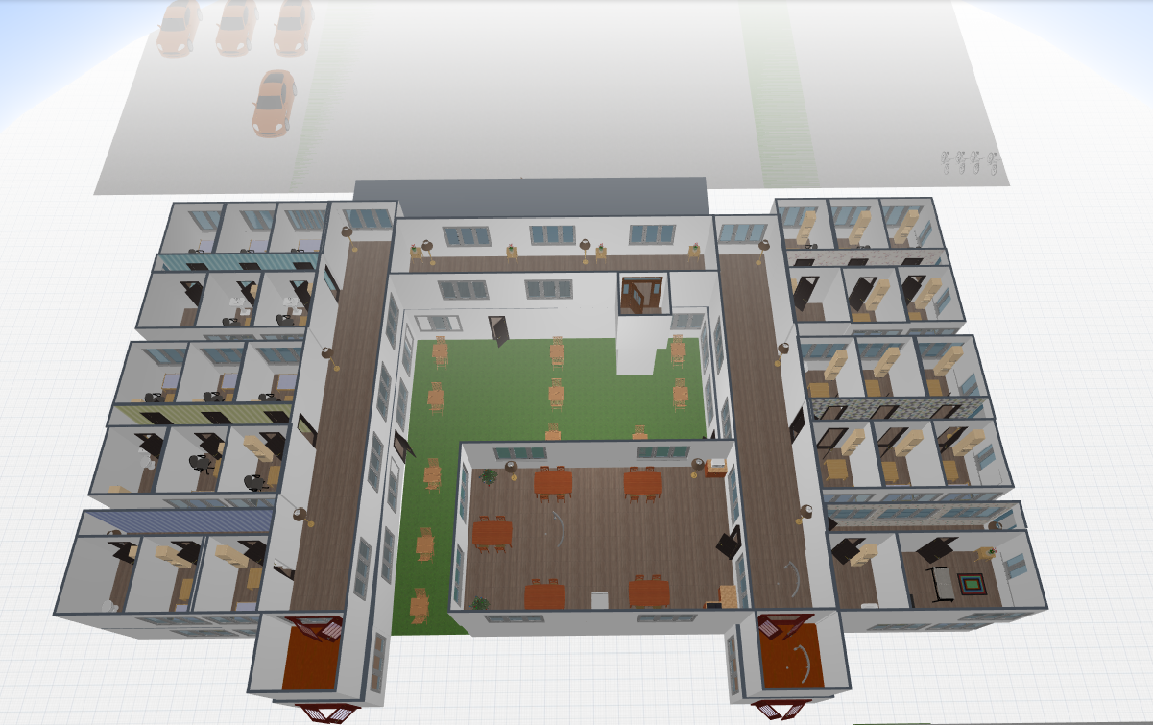
Floor 2 (Screenshots) 3D View

Slide 10
Potential Improvements
As a hospital we wish to implement the detailing of each wings.
The Laundry and cleaning cards can be carried to a new sprint.
Roads and other nearby amenities can be next improvements.
A good means to collaborate and work in harmony is a big take away.

Slide 11
Citations
Design Platform: planner5d.com SDLC Platform: Trello.com
Link to Final 3D Design of Hospital: Check out our design here!

